Slide 1

Writing Your Ageless Resume
Colleen Paulson

Slide 2
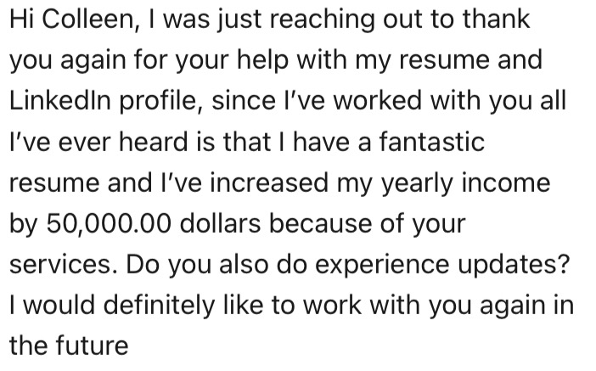

What can a new resume do for you?

Slide 3
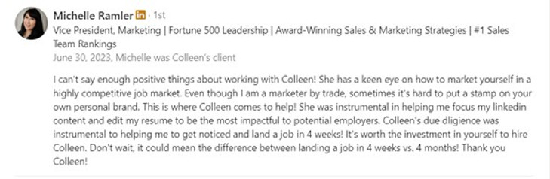

What can a new resume do for you?

Slide 4
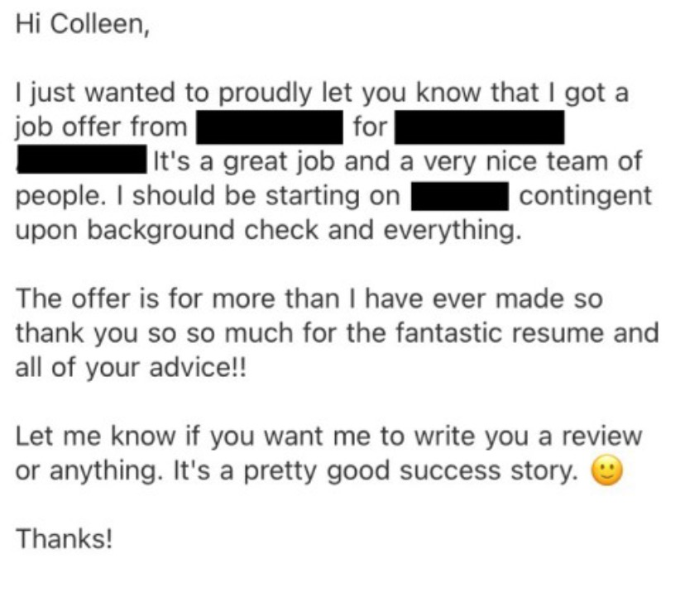
What can a new resume do for you?

Slide 5
Course Goals
Take you through the process that I use with my executive clients
  10 resume examples
  50+ questions to ask yourself
  100 action verbs that you can use
Provide up-to-date advice on revising your resume
Talk through common scenarios and questions
Give you the tools that you need
Address age-specific concerns
Increase your confidence

Slide 6
Modern Resume
Confusion
Millions of templates
Lots of graphics/pictures
Is anyone even looking at my resume?
Do I need fancy templates to be seen?
What does it mean to be ATS-compliant?

Slide 7
Modern Resume
Answers
You don’t need pictures
You don’t need graphics
You don’t need a fancy template
You don’t need to pay for an ATS-compliant template

Slide 8
Modern Resume
Answers
Stick to the basics
Align your resume with target jobs
You can use any plain resume template
Complicated templates can have ATS issues
Recruiters and hiring managers are looking for results – not fancy templates

Slide 9
Begin with the end in mind
Identify your goal role before you start writing your resume
Use your resume to show how you can do the job
Show your unique value proposition

Slide 10
You don’t have delete *old* experience
Some coaches say: only show experience from the past 15 years
You can show ALL of your experience and be successful
We just need to be creative about how we show this
(And if it’s not relevant, you don’t have to include it)

Slide 11
Basic Resume Format tips
Plain font
LinkedIn URL
2 page maximum
Chronological (not functional)
City/State only (no home address)
Clean format (columns can be tricky)
Minimal graphics (really, you don’t need them)
No picture (unless it’s an acting resume or executive bio)

Slide 12
Words and phrases to avoid
“Seasoned”
“Experienced”
"Responsible for"
“Mobile number”
“Objective statement”
"References available on request"

Slide 13
Resume Sections
Your Contact Information
Title/Headline
Executive Summary
Skills
Experience
Education
Additional Sections (Executive Development, Technical Skills, Certifications, Professional Coursework, Volunteer Work, Board Roles, Languages, Awards, Presentations, Publications, Affiliations)

Slide 14
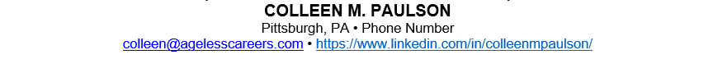


Contact information
LinkedIn URL
City/State only (no home address)
Professional email address (not your work email)

Slide 15
Title/headline
Think about what sets you apart from the competition – these are the things to emphasize in your headline/executive summary.
You can tweak the headline for each resume based on the job title.
Use your target role (vs current role)
Summarize your experience
Or you can choose a general statement (i.e. Executive Leadership, Fortune 500 Leader).
You can also add in the top skills and keywords required for the role.
Be creative!

Slide 16
Title/headline sample phrases
Fortune 500 HR leader
VP, Procurement
CMO Advisor
Technology Transformation
Award-Winning Sales Leader
Multi-Million Dollar Projects
M&A Expertise
Army Veteran
PMP Certification
Community Board Leader (Do you volunteer in your community? If so, highlight it!)

Slide 17
Title/headline examples
EXECUTIVE LEADERSHIP: HEALTHCARE TRANSFORMATION
VP, BUSINESS OPERATIONS & STRATEGY | FORTUNE 50 EXECUTIVE
VICE PRESIDENT, REAL ESTATE & FACILITIES | FORTUNE 500 | INDUSTRY BOARD LEADER

Slide 18
Executive summary
What message do you want to send to future employers?
Find common threads in your experience
Highlight top results (with numbers)
Showcase skills
Discuss graduate degrees or other qualifications that set you apart from the competition

Slide 19
Executive summary
If the 2nd page of your resume includes:
Board experience
Masters or advanced degrees
Pertinent coursework or certifications
Experience with a top name company
Big results and projects that you are proud of
... then you want to add that to your executive summary.

Slide 20
Your opening sentence
1. Start with an adjective that describes you (versatile, insightful, innovative, award-winning, etc)
2. Then use a role description: either your title (SVP of Sales, Project Manager) or a descriptor (HR Executive, Procurement Leader)
3. Next, discuss what your value add is (delivering multi-million dollar growth, leading billion dollar projects, transforming HR organizations)
4. Finally, discuss who you help (healthcare companies including UPMC Healthplan, start-ups and global technology leaders including Google, wide range of companies including Fortune 500 leaders AT&T and Comcast).

Slide 21
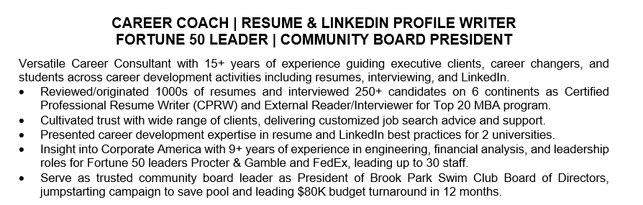
Executive summary example

Slide 22
Forming your supporting statements
Share your biggest career highlights
Quantify results wherever you can
Make sure to connect with target roles
Use the action verbs on page 12 to show highlights

Slide 23
Sample sentence starters
Known as
Expertise in
Recognized as
Build relationships with
Subject matter expert in
Serve as Strategic Advisor
Serve as Executive Advisor
Form high-performing teams
Consistently expand business skills

Slide 24
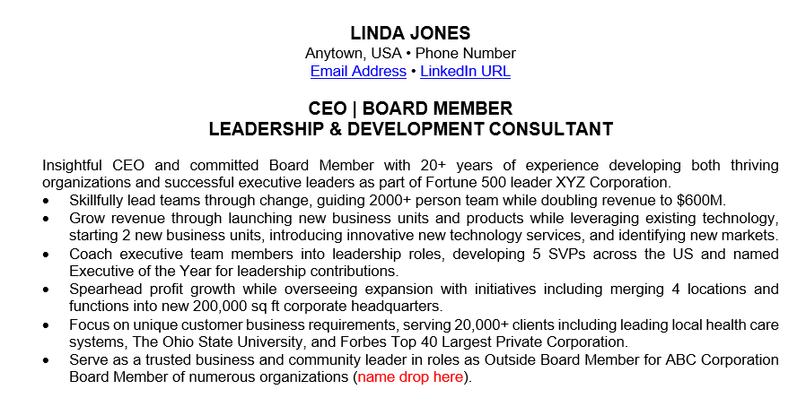
Executive summary example

Slide 25
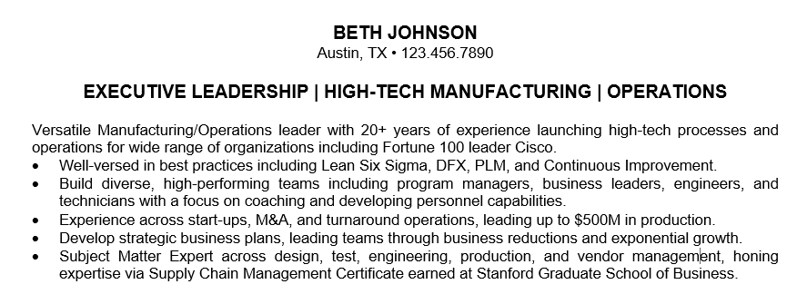
Executive summary example

Slide 26
Skills
Review job descriptions to see what skills are most important
Highlight both hard and soft skills
  Hard skills: IT solutions, financial statements, P&L management
  Soft skills: executive leadership, goal setting, problem solving

Slide 27
Highlight Transferable Skills
Very important for career change or industry shift
Transferable skills are the skills that you are currently using (or have used in the past) that you can directly use in your new role.
Closely read the target job description and identify the top skills required.
This is particularly important in your LinkedIn profile as recruiters will search for job candidates based on skills required.

Slide 28
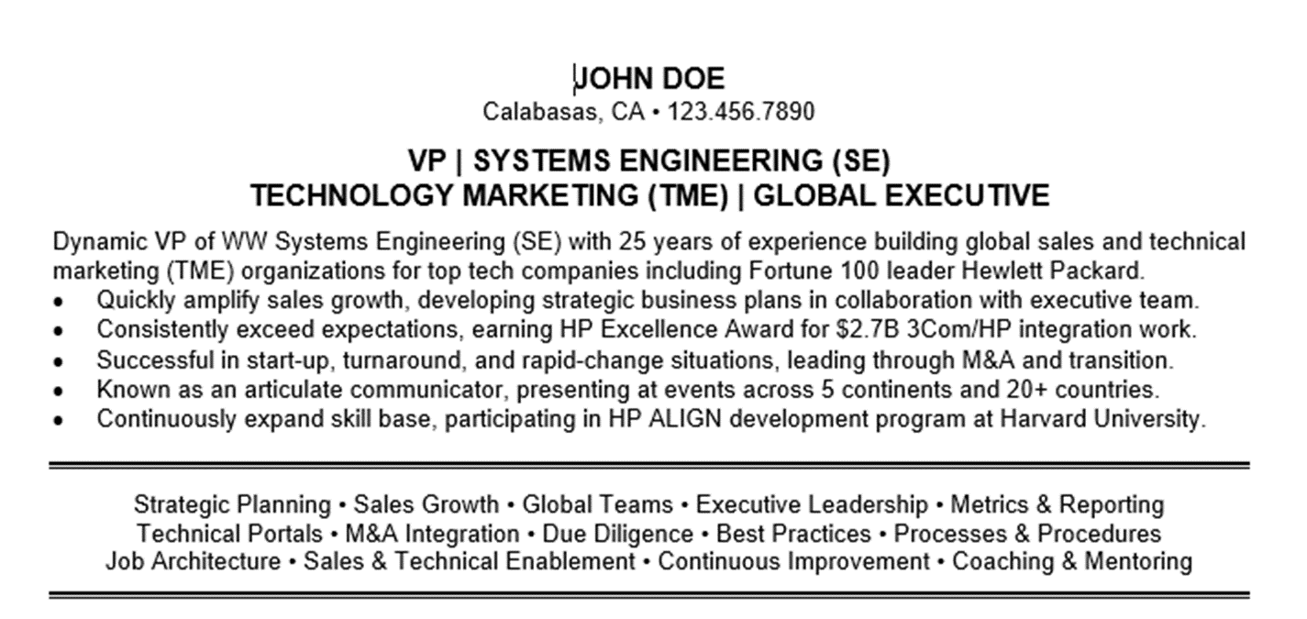
Skills example

Slide 29
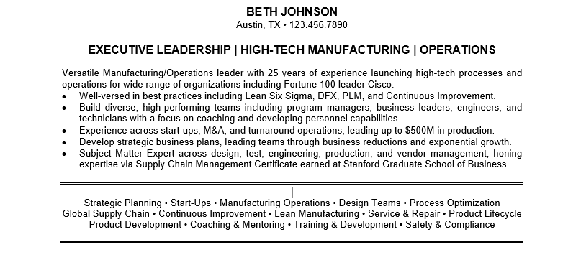
Skills example

Slide 30
Experience
Start with most recent experience and work backwards
Outline job responsibilities first
Share results in bullet-point format
Think through what is most pertinent to your target role
Stick with 5-7 bullets per role
  Use headers to separate bullets and grab the reader’s attention

Slide 31
Ask yourself the right questions
Who are you reporting to?
How large ($$) is your division?
How many projects did you lead?
How much savings did you deliver?
How many clients did you manage?
What is the size ($$) of your project?
How much (%) did you improve productivity?
What is the annual revenue of your company?
Did you manage a budget/P&L? If so, how big?
How many people report to you (direct/indirect)?
How many people are you leading on your project?
How much revenue is associated with your product?

Slide 32
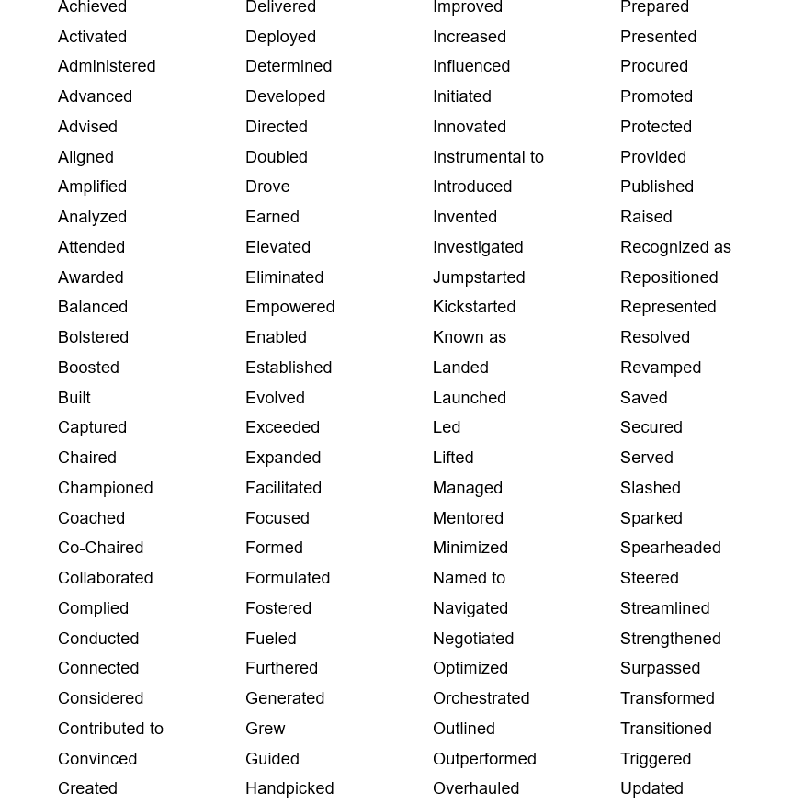
Use action verbs to draw the reader in

Slide 33
Paragraph outlines duties
Briefly discuss your duties in each role
Align with target role
Keep this to a minimum – focus on results

Slide 34
Numerical results are everything!
Recruiters and hiring managers want real evidence that you can do the job and the best way to demonstrate your capabilities is to quantify your results. Processed 1500 applications in 12 months …
Improved test scores by 10% YOY…
Managed $100,000 project …
Directed 5 employees ….
Slashed expenses by $50,000 ….
Boosted efficiency by 15% ….

Slide 35
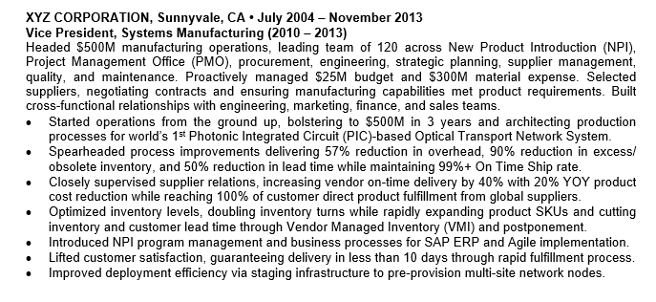
Experience example

Slide 36

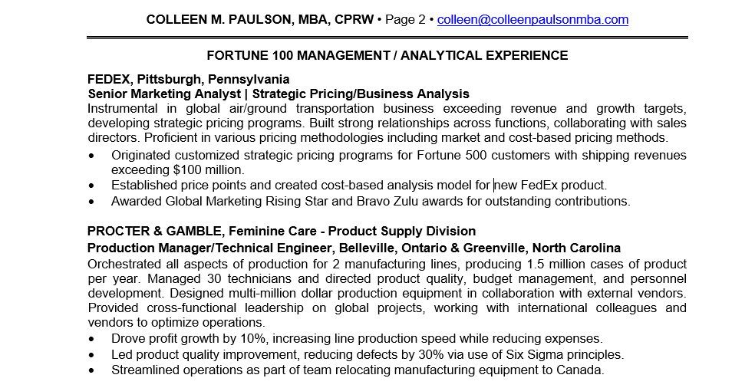

Slide 37
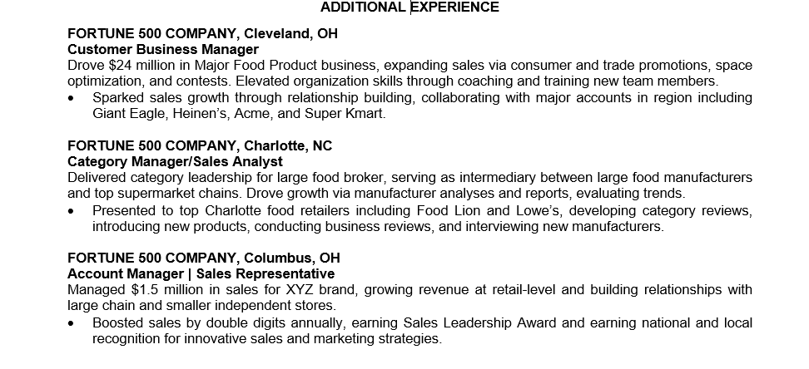

Slide 38
Education
Share all degrees (or coursework if degree is in progress)
Share minors, honors, and other pertinent information
You don’t have to share graduation year

Slide 39
Additional sections
Technical skills
Certifications
Professional coursework
Volunteer work (Community Leadership)
Board roles
Language skills
Awards
Publications
Presentations
Affiliations

Slide 40
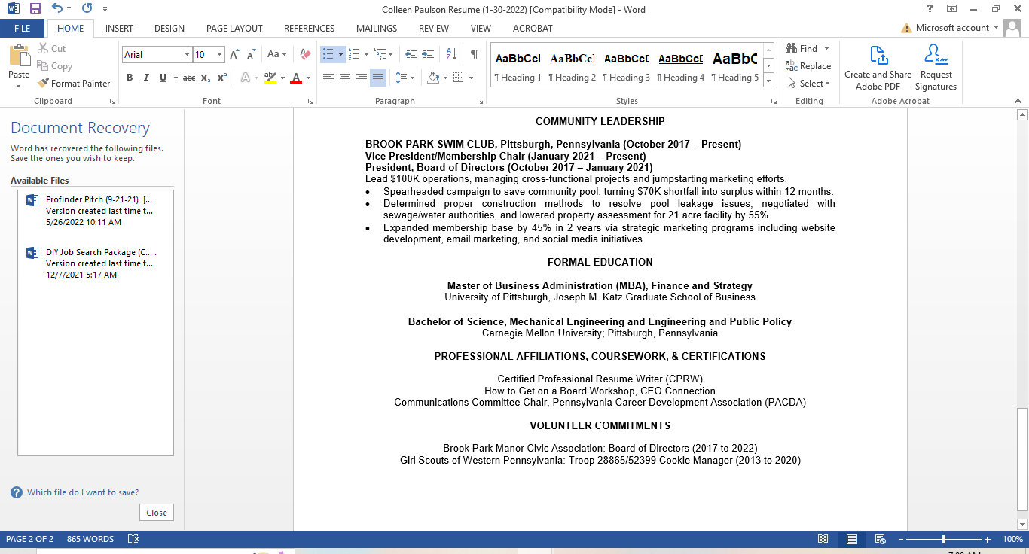
Education/additional sections example

Slide 41
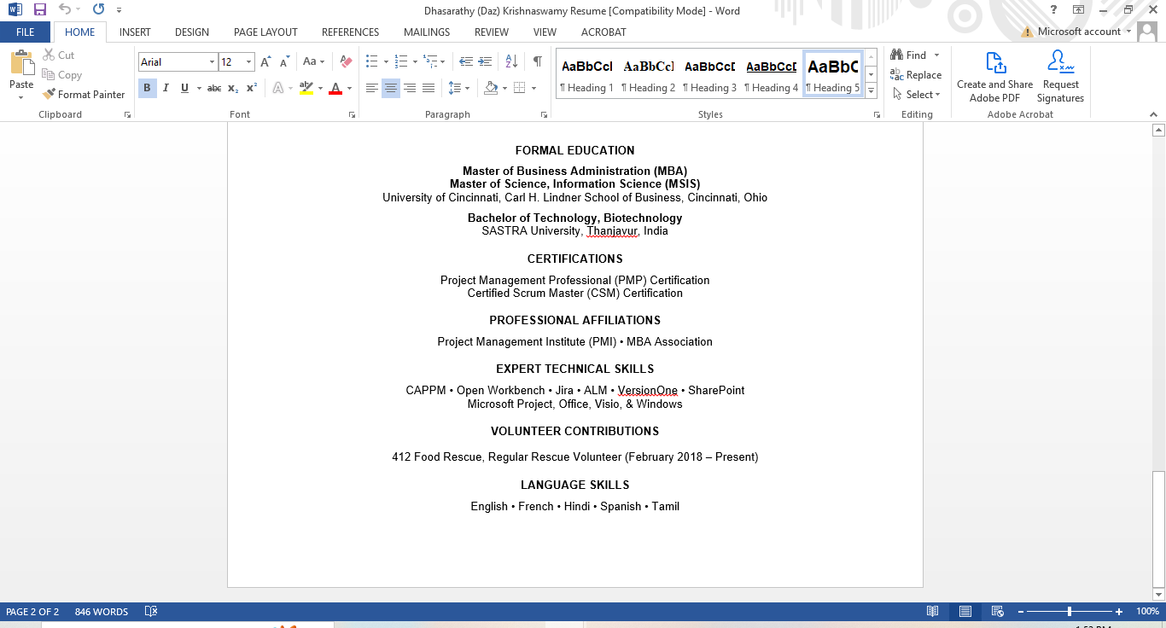
Education/additional sections example

Slide 42
Common questions for Gen X and Baby Boomer job seekers

Slide 43
What if I haven’t written a resume in years?
“Brain dump”
  Bullet points/brainstorming past experience
Find old performance reviews
Look through your emails
Review job descriptions
Use sample questions
Use LinkedIn for help

Slide 44
How do I talk about early career experience?
The answer is: it depends.
Is the early experience relevant to the roles that you are applying for?
Is it with a “big name” company?
Is it work that you would like to emphasize?
If the answer is NO, then you can choose to keep it off of your resume and we can discuss this as a brief career note at the end of your resume and share this without the years that you worked.

Slide 45
How do I talk about early career experience?
Experience includes roles as Project Manager for ABC Company and Business Analyst for XYZ Corporation. Highlights include managing team of 10 to drive 10% reduction in quality defects.
Experience includes various IT roles with ABC Consulting. Key accomplishments include delivering $10M technology upgrade for global Fortune 50 transportation leader (FedEx).
Experience includes HR leadership roles with Westshore Electronics and HP.

Slide 46
Early experience example
Experience includes leading roles including Senior Vice President, Marketing & Promotions for Fortune 500 Company and Marketing Director for ABC Corporation.
Key highlights include:
Spearheaded an $8 million advertising sponsorship, partnering with leading consumer brand.
Drove thought-leadership and created an advisory board and event series with prominent keynotes.
Sponsorship development drove billions in advertising revenue for multiple networks.
Developed integrated media sponsorships, custom content, and brand integrations; included award-winning programs.
Strategies generated millions in revenue and significant earned media promotion. Directed publicity and promotions for a location-based entertainment concept, including crisis management strategy.

Slide 47
How do I discuss my career break?
Use a career note to discuss your career break:
Career Note: Currently working on consulting project for XYZ Corporation.
Career Note: Completed volunteer work with North Hills Community Outreach and completed PMP coursework from 2021-2022.
Career Note: Was on caregiving leave from 2014 – 2017, serving as McKnight Elementary School PFA President. Led $25K fundraising campaign to purchase new playground equipment.
MILITARY EXPERIENCE: Experience includes roles as HR Specialist and Recruiter with United States Navy and United States Army Reserves. Held Top Secret SCI Security Clearance. Won numerous awards for service.

Slide 48
How do I talk about consulting projects?
You can talk about these consulting projects as a career note (see above) or as a separate section (see my resume in Example 1 for how I discuss my work as an Independent Contractor).
I think either of these methods are fine – if you don’t have a lot of room, then the career note should be OK. If you are looking to emphasize this work, then you can list this work out as a separate section.
You can also create a LinkedIn business page so that this work appears more cleanly in LinkedIn.

Slide 49
How do I write a career change resume?
If you are looking to change careers, you are going to have to show how your transferable skills will apply to your new role.
Let’s say that you are looking to move from engineering to financial analyst: you are going to emphasize all of the skills that you used as an engineer (i.e. problem solving, project management, analytics, research, etc) and show how you will use those skills in your goal role.
One quick job search hack is to filter job postings and look for those that consider "transferable skills" - this will give you an idea of companies that are actively accepting career changers.

Slide 50
How do I target remote roles?
As I’m sure that you have heard, the number of remote roles is declining dramatically.
If you are looking to land remote work, you need to show how you have succeeded in a remote work situation in the past.
Be specific! Say things like:
• Formed new remote organization, coaching team of 15 new direct reports and building collaborative group with focus on teamwork and communications.

Slide 51
How do I find part-time work?
I typically use FlexJobs when looking for part-time roles (there is a cost to join, but if you want part-time work, it is a good source of jobs). If you have previously worked on a part-time, flexible, or contract basis, I would discuss this:
• Evaluated admissions applications for Top 20 MBA program, providing support on a seasonal basis.
• Drove success for healthcare start-up in part-time role, serving as social media subject matter expert.

Slide 52
How do I discuss a short-term job?
This happens all of the time!!
I would prefer that you discuss the role in some way on your resume – this is a lot more common than what you think it is and I believe it’s better to show this (versus hide it or pretend that it didn’t happen).
I would discuss it as a career note – when you go into the interview, I would not speak negatively about the employer, but would briefly frame what you learned from the role (and emphasize how you can use those learnings in your new role if you can do so).

Slide 53
How do I transition from entrepreneurship back to working for someone else?
Entrepreneurs re-entering the paid workforce can give employers pause for a number of reasons. Employers will wonder:
  Can I pay you enough?
  Can you take direction as an employee (vs giving direction as an entrepreneur)?
  Will you leave when something better comes along?
  How will your entrepreneurial experience translate to the new business?

Slide 54
How do I transition from entrepreneurship back to working for someone else?
Here are my tips:
Narrow your search: you could probably go in a lot of different directions, but be clear on the types of roles/companies that you are targeting.
Demonstrate how you can solve the employer’s pressing issues: as an entrepreneur, one of your superpowers is solving problems. Closely read the job description and research the company’s current situation. Outline how you can step in and drive growth, cut costs, etc.
Tackle the elephant in the room in your cover letter, LinkedIn, and interview: be transparent about your goals and counter potential concerns throughout the process. Show that you are committed to building relationships.
Be careful about using lofty titles: You might have been CEO of your company, but some companies are going to be afraid of the CEO title – especially if you are targeting a VP or below role. Don’t be afraid to change your title in your resume and LinkedIn so that it’s closer to the title that you are targeting.

Slide 55
Should I use a functional resume format?
I don’t recommend using a functional resume format
Use your Executive Summary to summarize your experience and show the common threads in your experience
If you really want to, you can use a “Selected Career Highlights” section

Slide 56
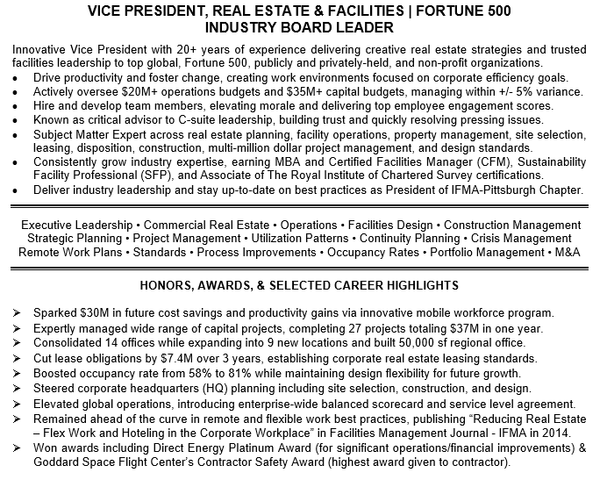

Slide 57
If I’ve worked at one company for a long time, how should I break out my roles?
Can I show multiple roles together?
Answer: It depends!
  Our goal is to position you for your target roles, so you always want to highlight the experience that aligns with your target.
  You can break out experience in projects or with bullets – whatever you feel tells your story best.

Slide 58
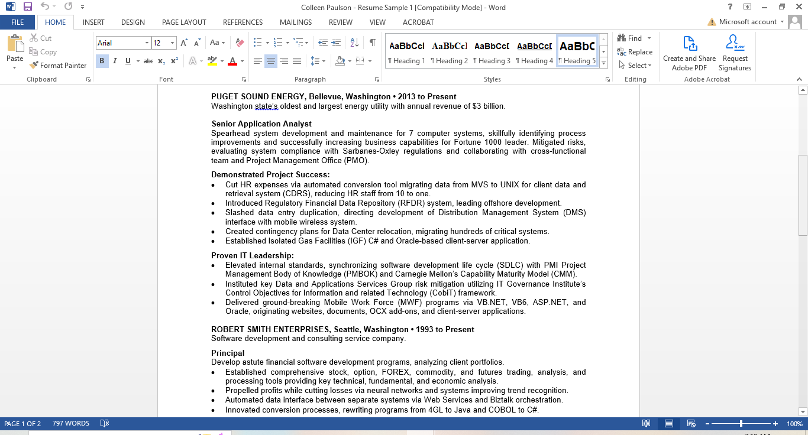

Slide 59
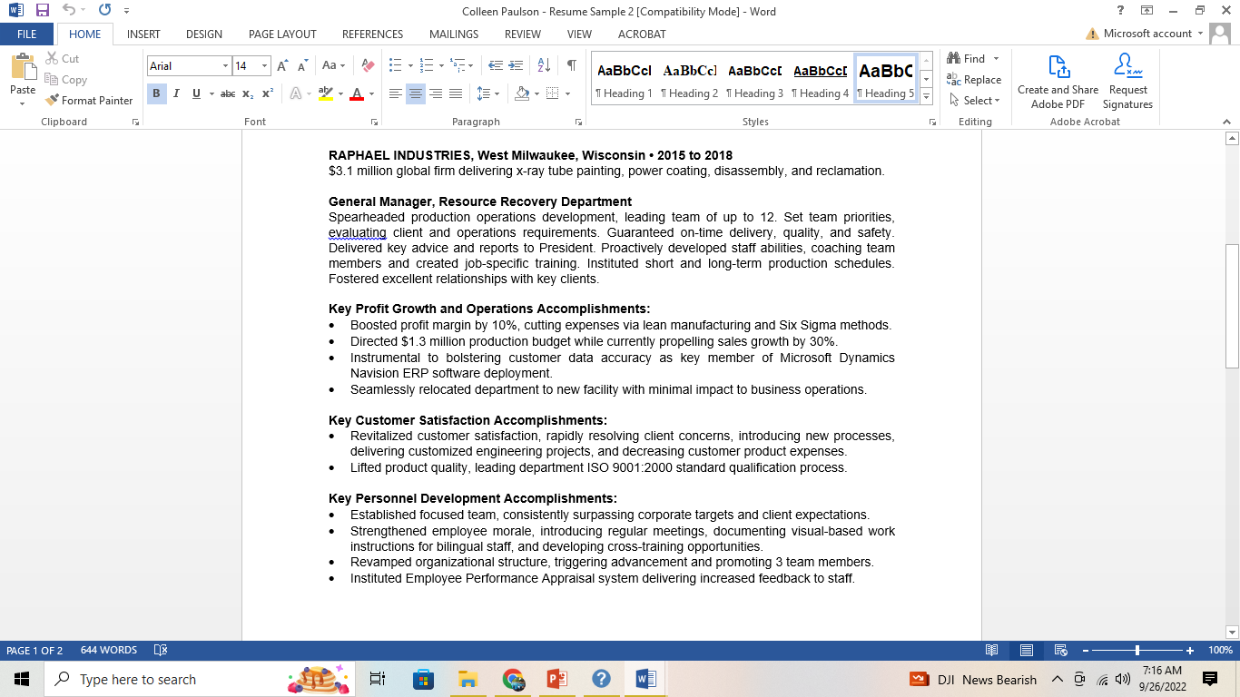

Slide 60
Should I discuss my hobbies and interests?
If your interests align with the role that you are applying for, then I would add that information in.
Otherwise, I would keep it out due to bias concerns.

Slide 61
Put it all together
Establish clear career goals upfront
Demonstrate your value through numbers
You don’t have to erase “early” experience
Use your headline/executive summary to show your unique value

